Slide 1



Vertical Slice Architecture
Jimmy Bogard
@jbogard
github.com/jbogard
jimmybogard.com

Slide 2

History Lesson

Slide 3
Traditional n-tier
UI Layer
Business Logic Layer
Data Access Layer
Database

Slide 4
Organizing by layer
Person.cs
PersonController.cs
PersonService.cs
PersonRepository.cs

Slide 5
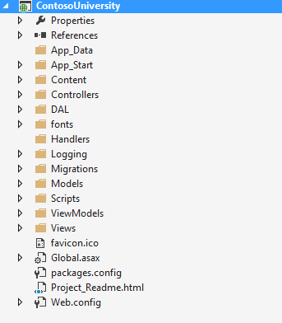
Areas of change

Slide 6
Vertical Slices

Slide 7
Move code to single place

Slide 8
Move service methods to classes
Invoice Service
void Approve()
ApproveInvoice {}
void Reject()
RejectInvoice {}
void Flag()
FlagInvoice {}

Slide 9
Modeling requests
Input
Request Handler
Output

Slide 10
Request/Response with MediatR
IRequest<T>
IRequest
Handler<T>
T
Task<T> Handle(
IRequest request) {
}

Slide 11
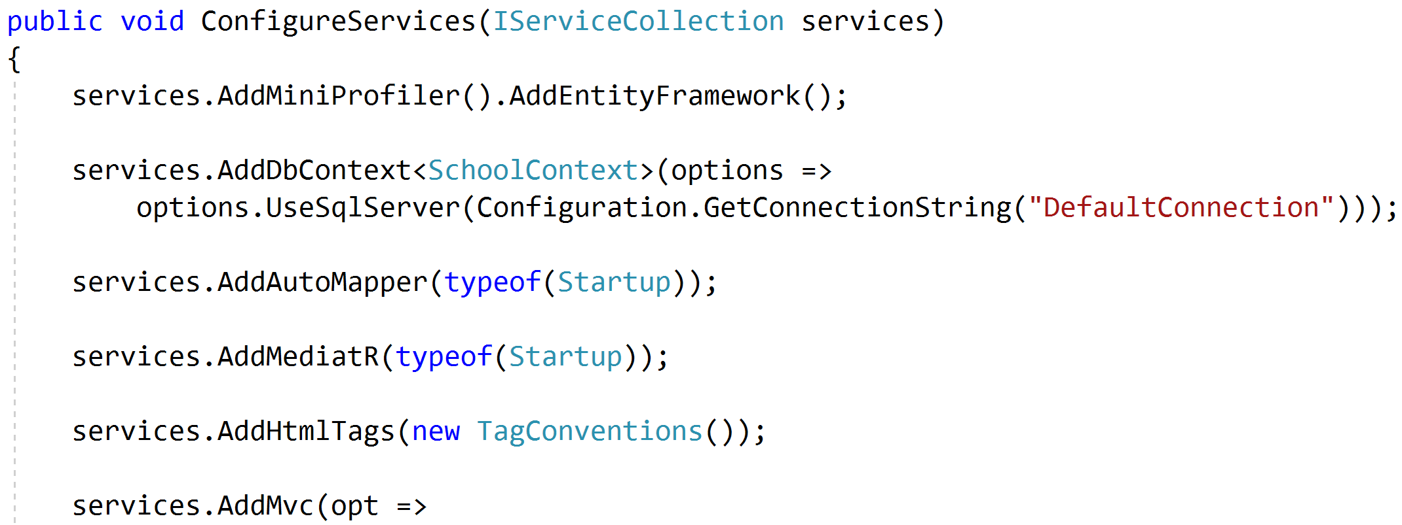
Registering MediatR

Slide 12
Commands and Queries
Web App
GET
Query
Handler
Response
Query
POST
Command
Handler
Response
Command

Slide 13
One model in, one model out
Query
Handler
Response
Command
Handler
Response

Slide 14
Complete encapsulation
Request
Response

Slide 15
Modeling Queries
Query
Handler
Response

Slide 16
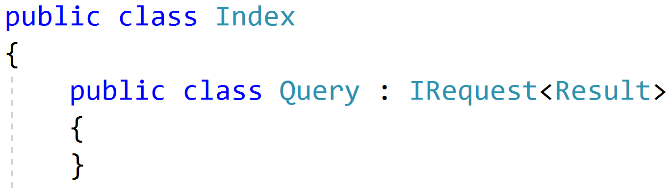
Simple Queries

Slide 17
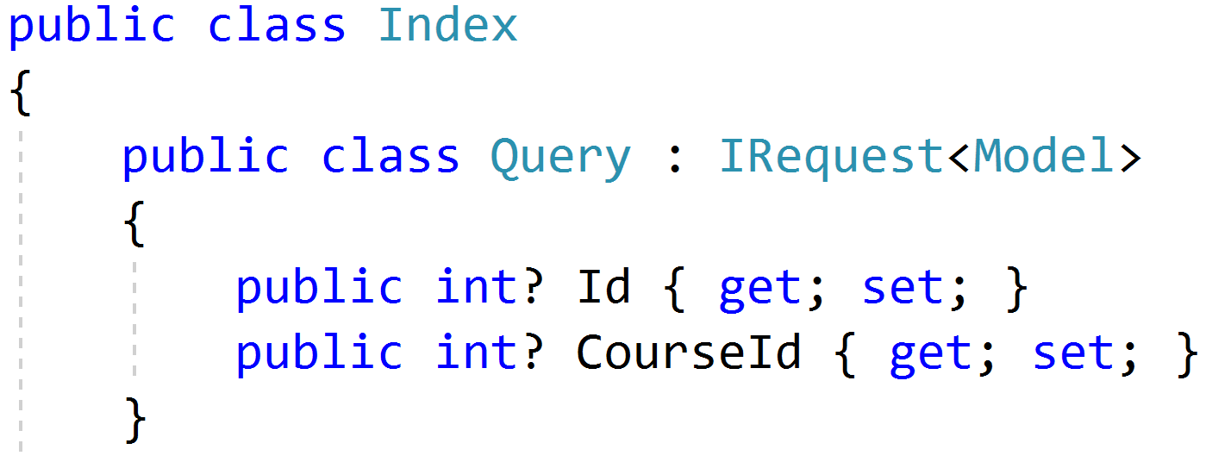
Parameterized Queries

Slide 18
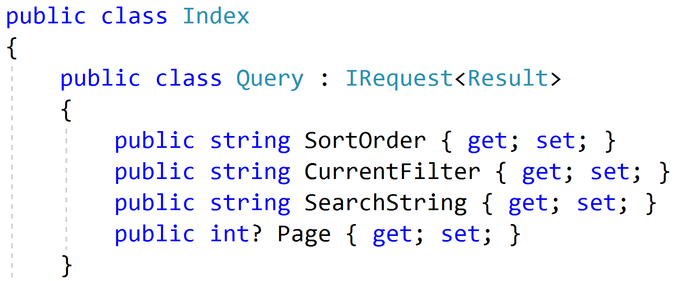
Paging/Sorting/Filtering

Slide 19
Modeling Responses
Query
Handler
Response
View

Slide 20
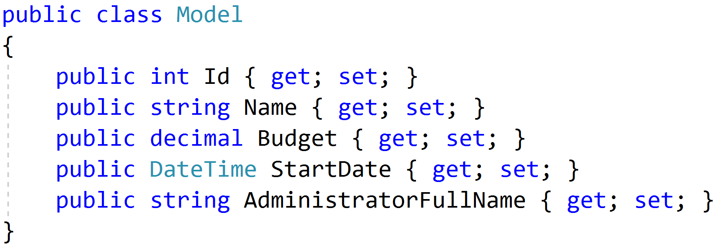
Simple Response

Slide 21
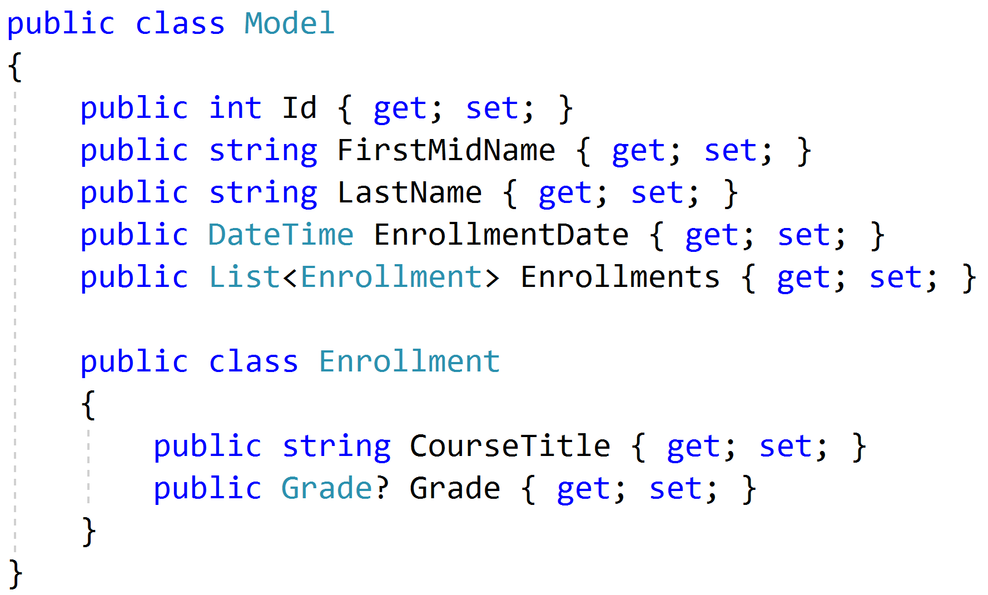
Complex Response

Slide 22
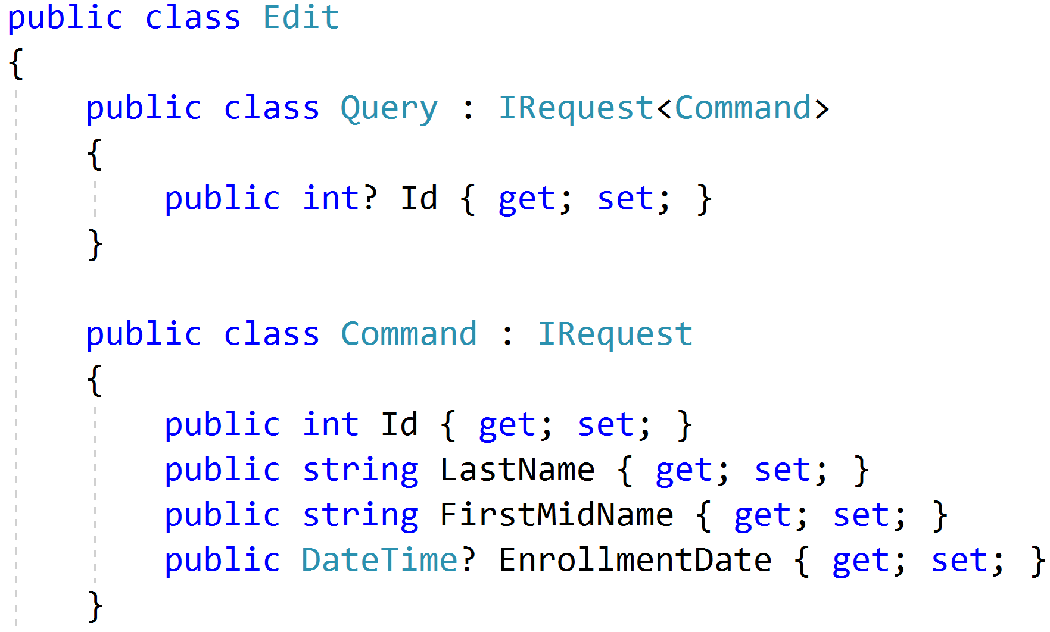
Command/Query Duality

Slide 23
Modeling Commands
Command
Handler
Response

Slide 24
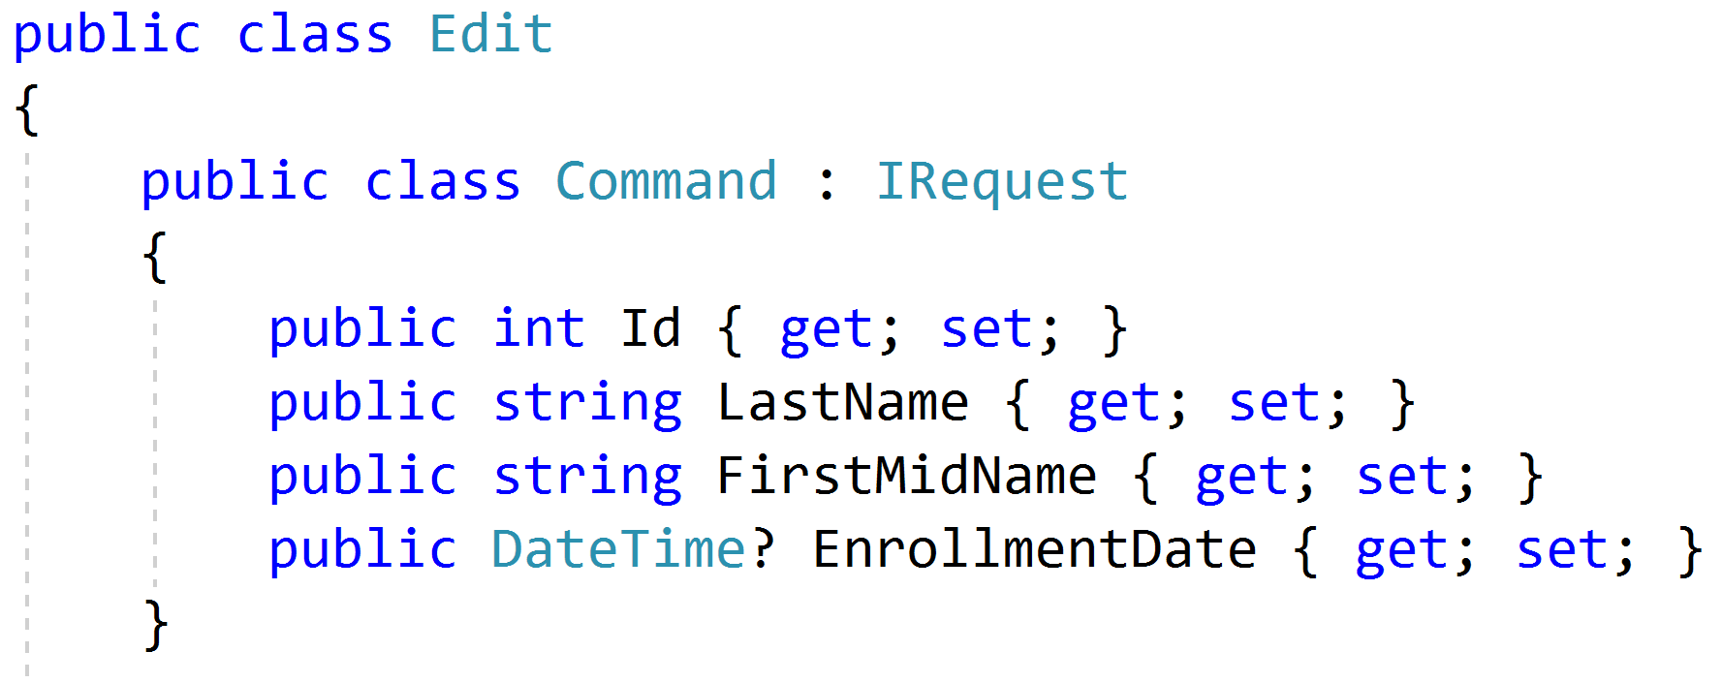
Simple Commands

Slide 25
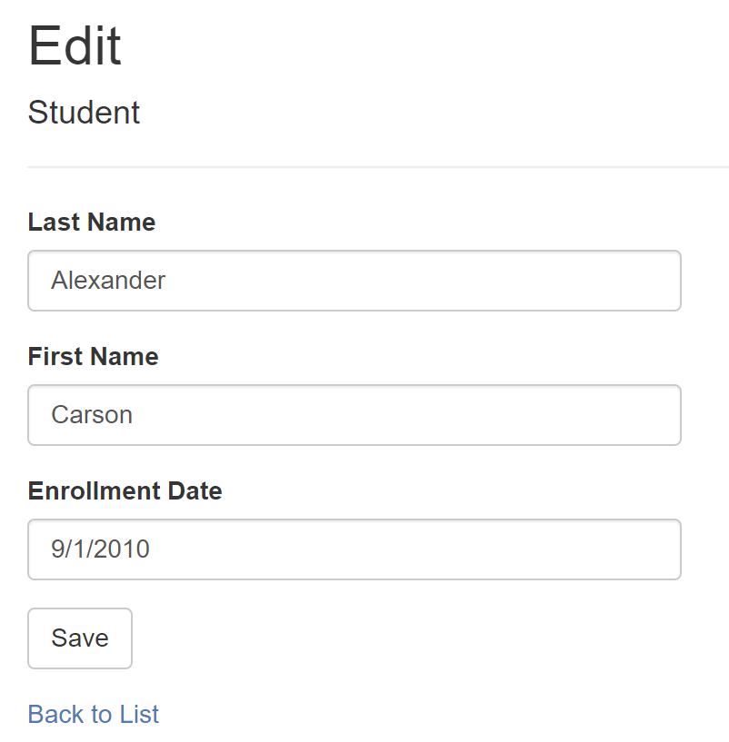
Model-Bound Types

Slide 26
Task-Based UIs
Transfer
Student Details
Request
Handler
Response
Transfer
Correct
Schedule
…
…
…
…
…
…
…
Correct
Request
Handler
Response
Schedule
Request
Handler
Response

Slide 27
Modeling Command Responses
Command
Handler
Response

Slide 28
Void Response
Command
Handler
IRequest

Slide 29
Command Result Response
Command
Handler
T
IRequest<T>

Slide 30
Success/Fail
Command
Handler
true/
false
IRequest<bool>

Slide 31
Creation
Create
Handler
Id
IRequest<Guid>
302 Found
/orders/081bcba7-89ff-4a41-af90-ded095160b99

Slide 32
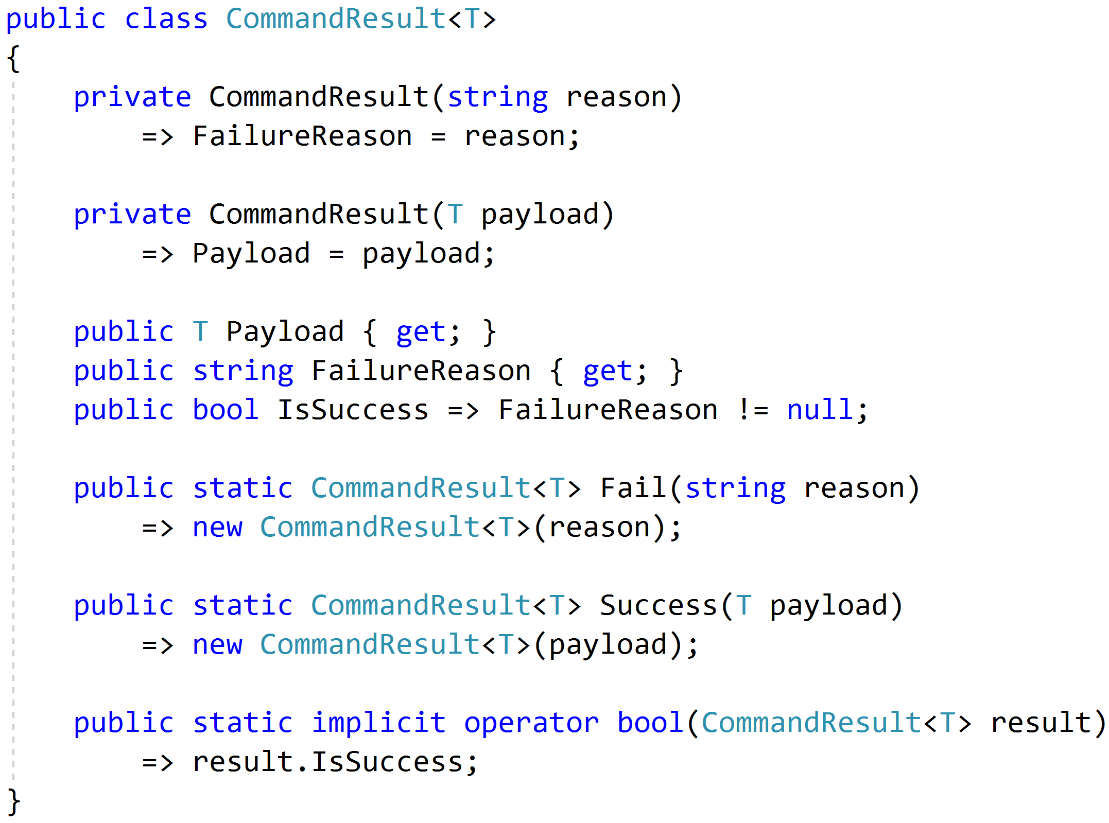
Complete Response

Slide 33
Modeling Query Handlers
Query
Handler
Response

Slide 34
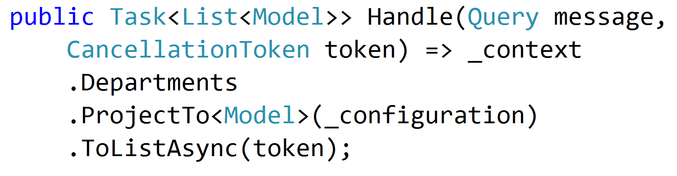
Simple AutoMapper Projections

Slide 35
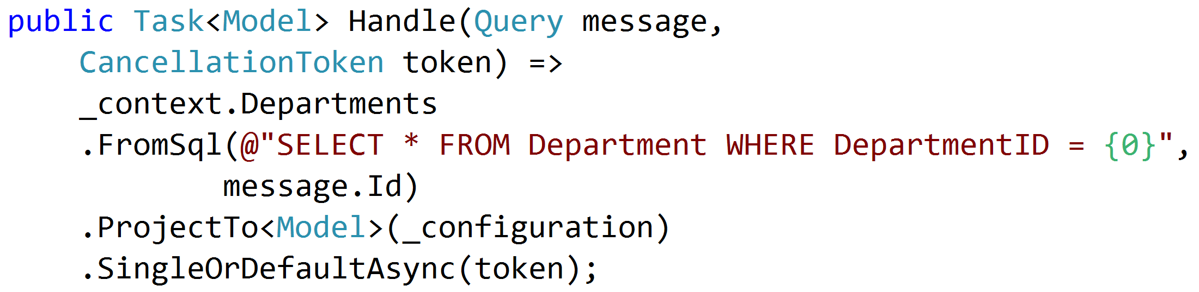
SQL Projections

Slide 36
Encapsulated Logic
Query
EF Core
Response
Query
Dapper
Response
Query
HttpClient
Response
Query
MeatGrinder
Response

Slide 37
Duplicate Logic
Query
Handler
Response
Common
Query
Handler
Response
Common

Slide 38
Refactor
Query
Handler
Response
Class?
Function?
Extension Method?
Common
Query
Handler
Response

Slide 39
Command Handlers
Command
Handler
Response

Slide 40
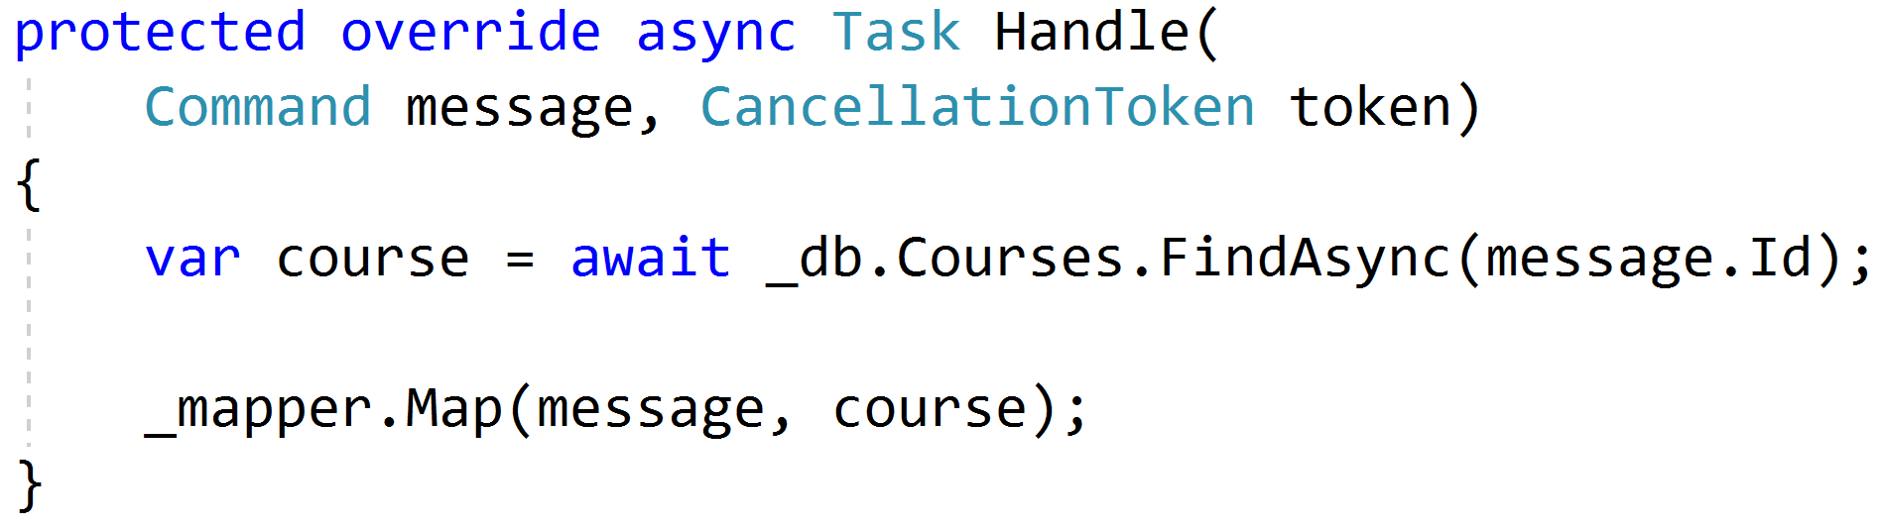
Procedural Beginnings

Slide 41
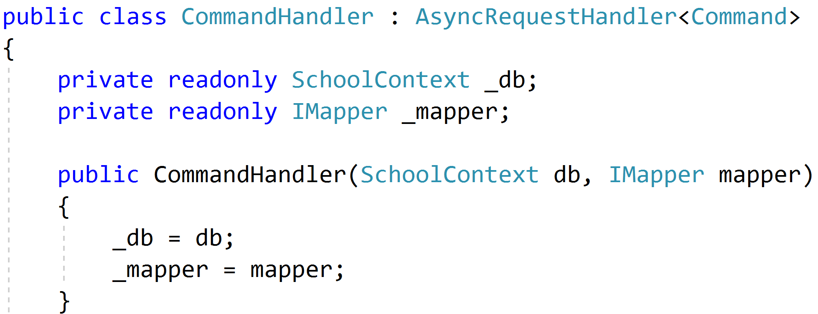
DI with no abstractions

Slide 42
Don't Panic!

Slide 43
Red
Green
Refactor

Slide 44

Code Smells
Large Class
Extract Class
Extract Subclass
Extract Interface
Extract Method
Replace Method
with Method Object
Compose Method
Long Method

Slide 45

Behavioral Smells
Combinatorial Explosion
Conditional Complexity
Feature Envy
Inappropriate Intimacy
Duplicated Code

Slide 46
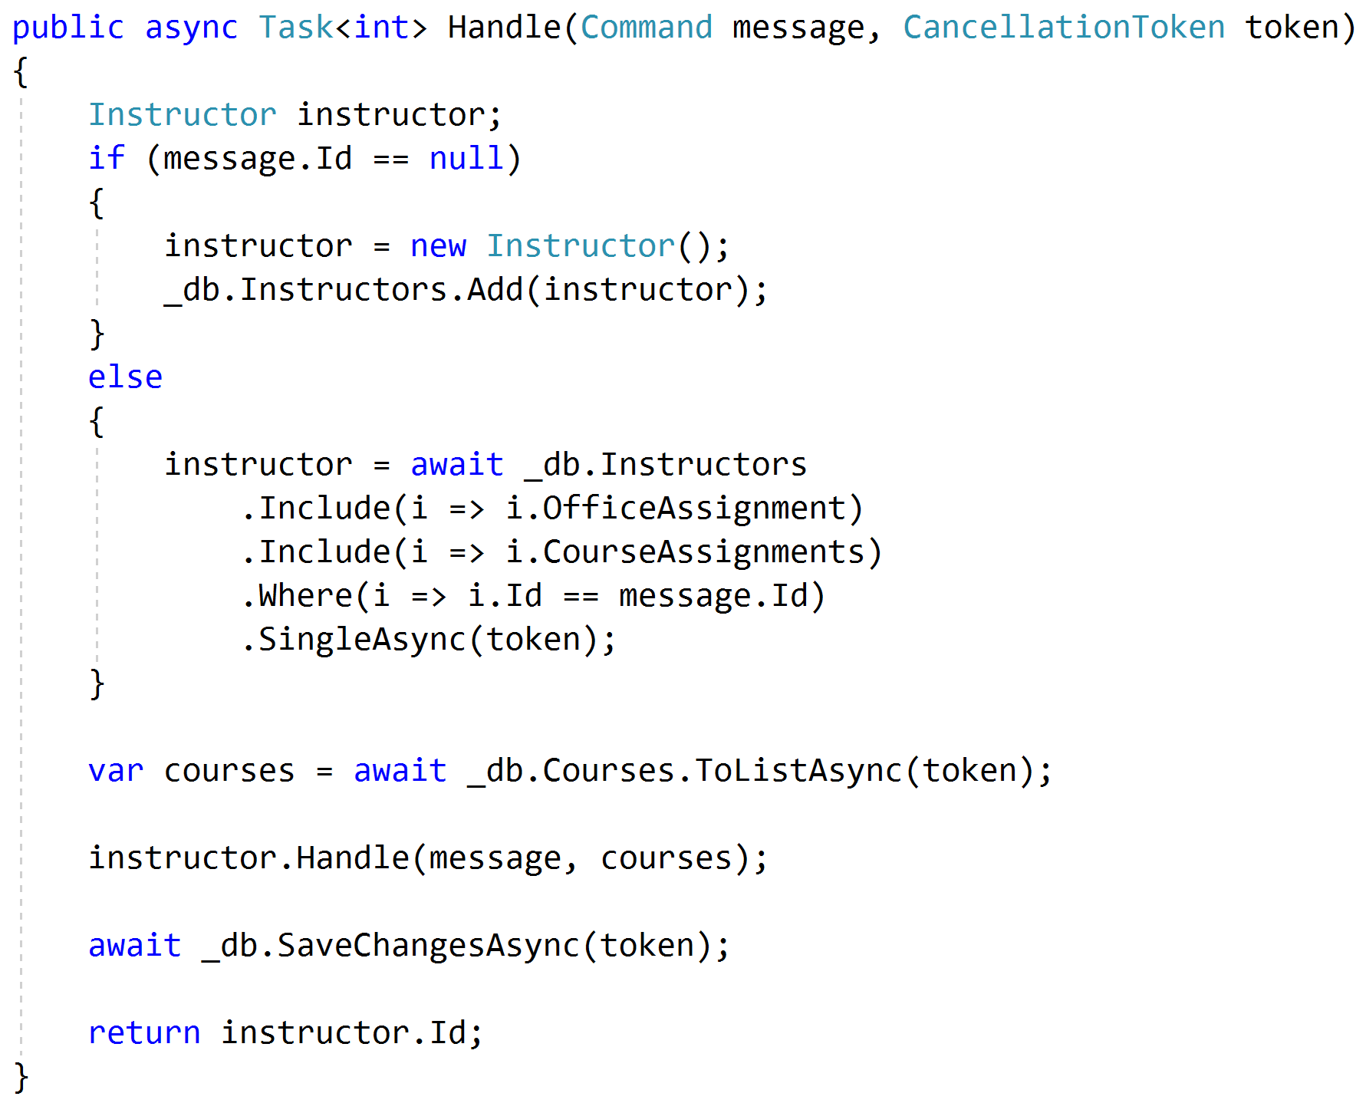
Push Behavior Down
Request
Handler
Domain
Response

Slide 47
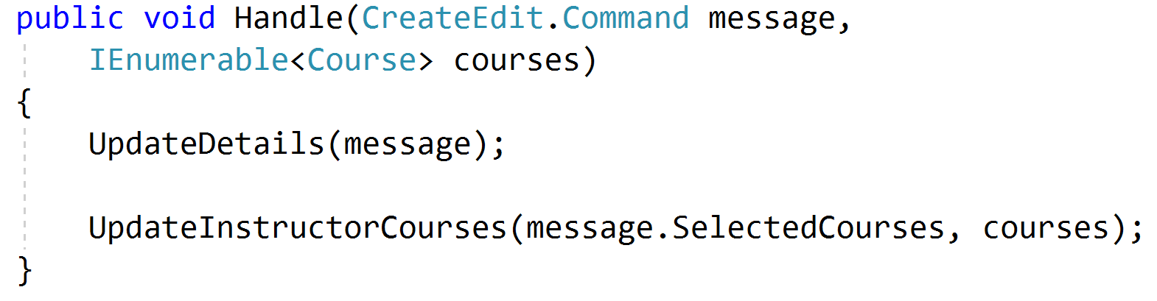
Encapsulated Domain
Request
Handler
Domain
Response

Slide 48
Validation Scopes
Command Validation
Domain Model
Request Validation
Request
Database
External Models

Slide 49
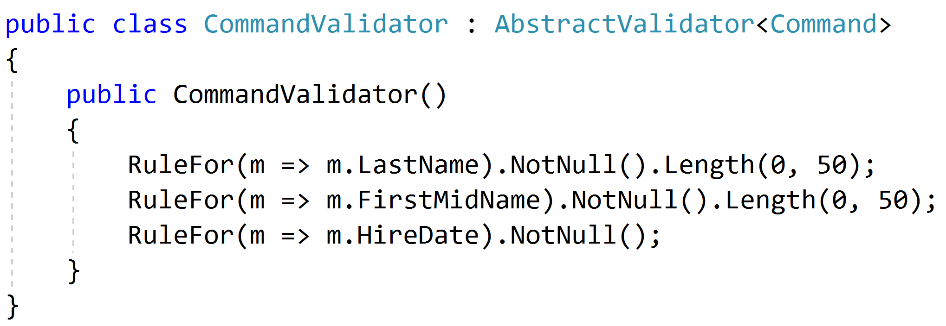
Request Validation

Slide 50
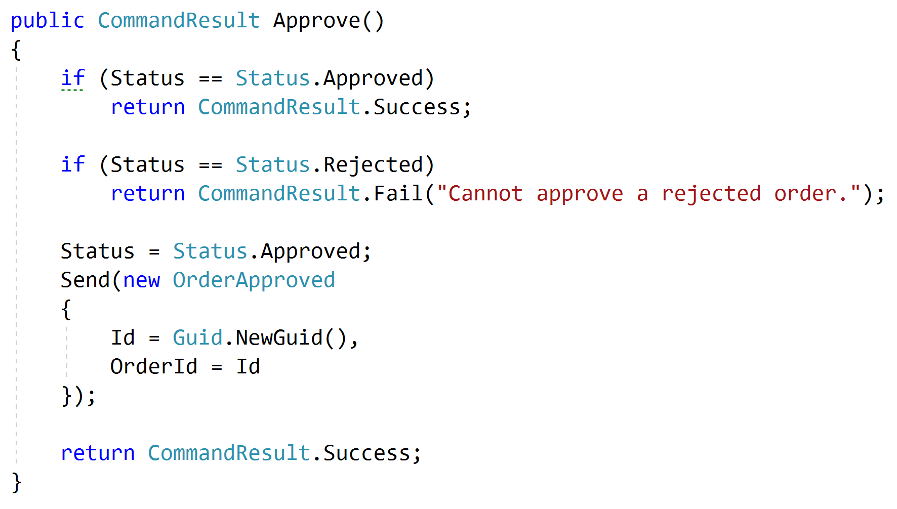
Domain Validation
Request
Handler
Domain + Validation
Response

Slide 51
Representations
Query
Handler
Response
????

Slide 52
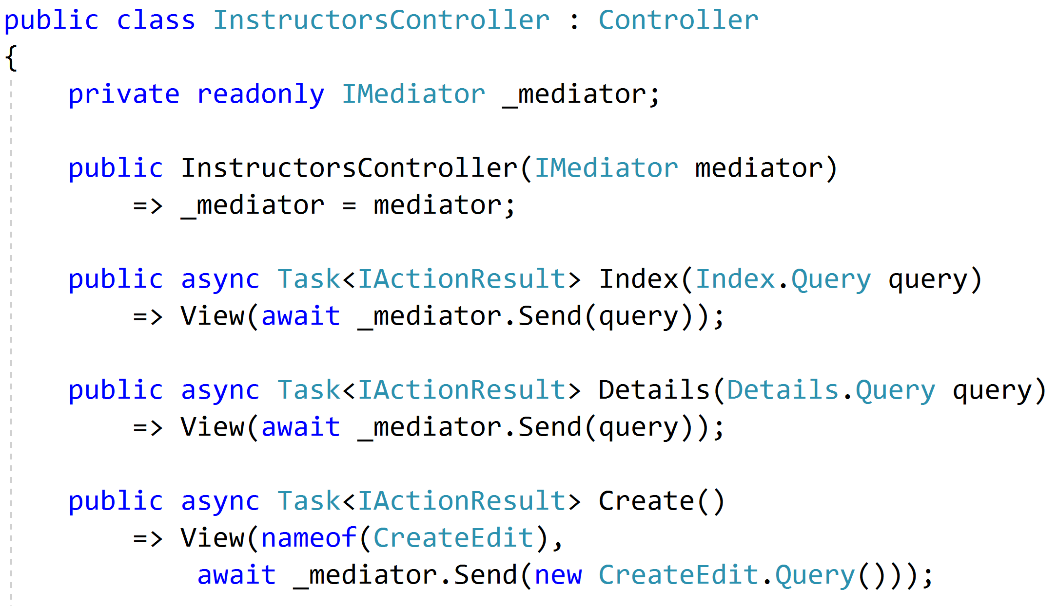
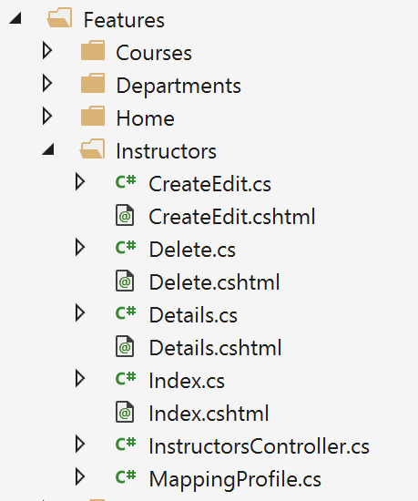
Controllers as routes

Slide 53
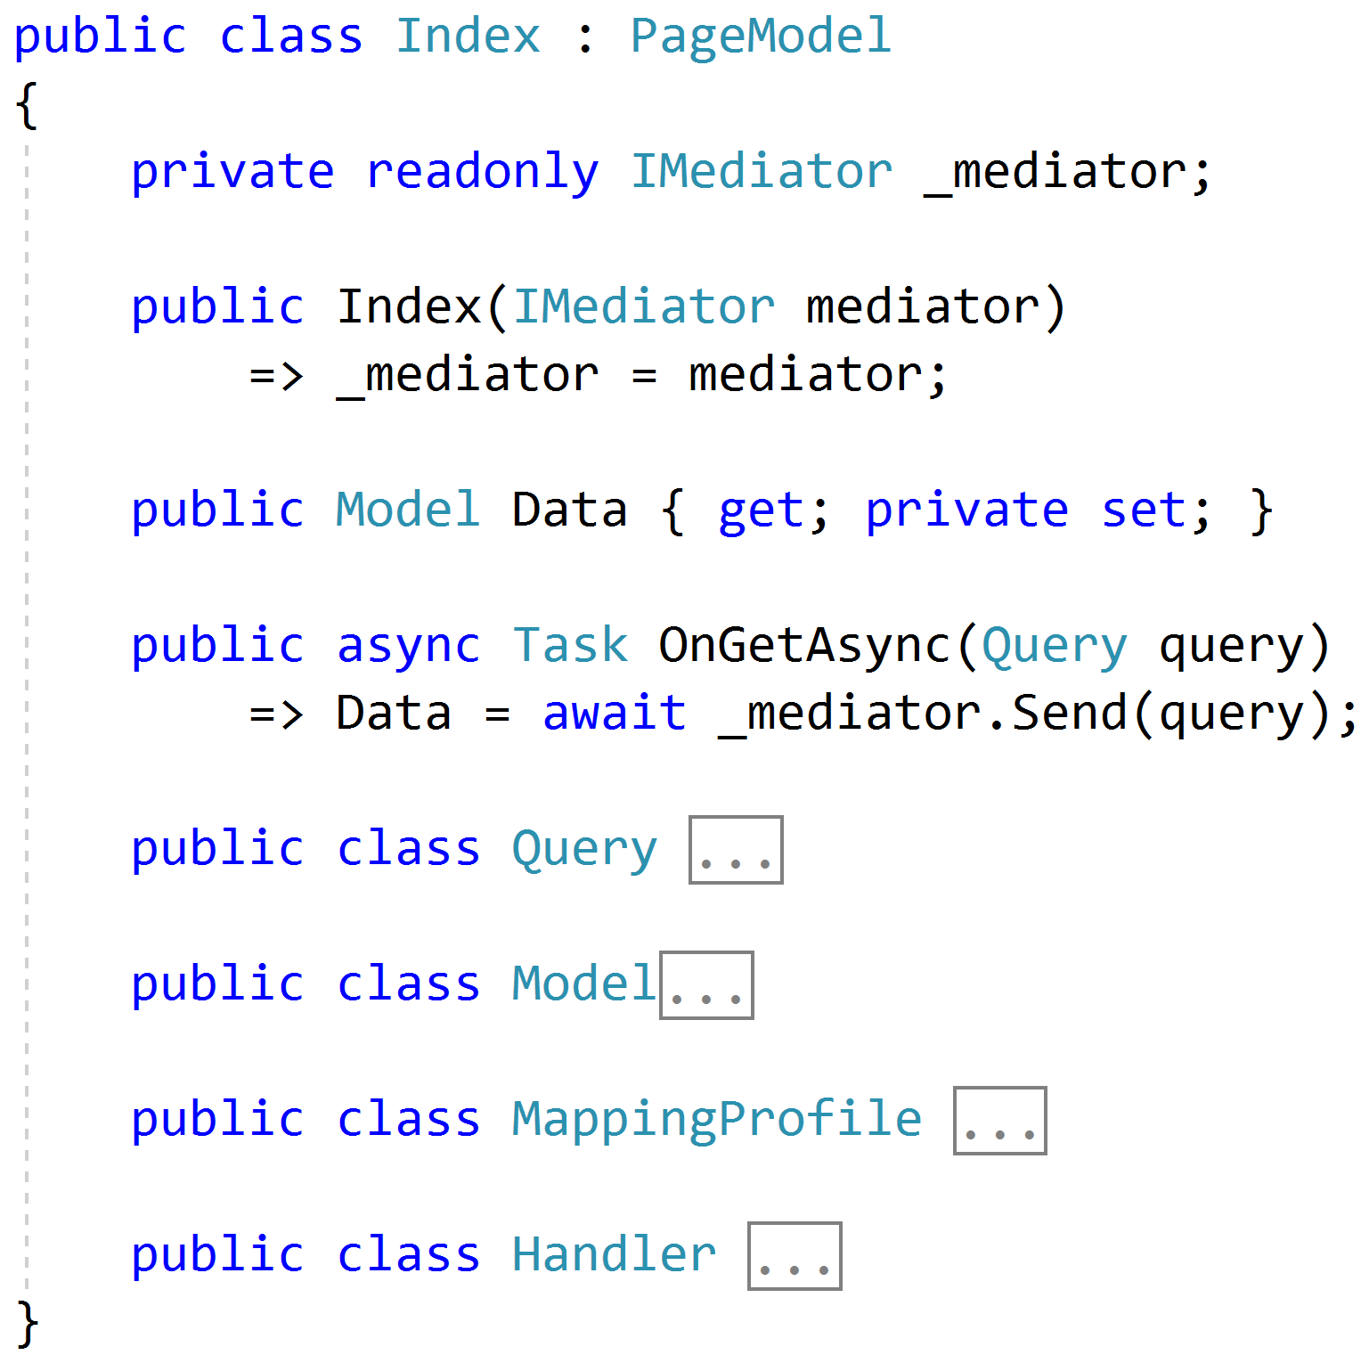
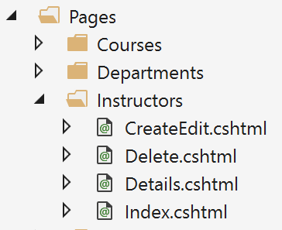
Razor Pages

Slide 54
Web APIs
/order/approve
Handler
/order/reject
Handler
Order json
/order/hold
Handler
/order/cancel
Handler
SPA

Slide 55
Cross-Cutting Concerns
Duplication
Request
Handler
Response

Slide 56
Pipeline Behavior (Decorator)
Pipeline Behavior
Request
Handler
Response

Slide 57
Stackable Decorators
Pipeline Behavior
Pipeline Behavior
Pipeline Behavior
Handler

Slide 58
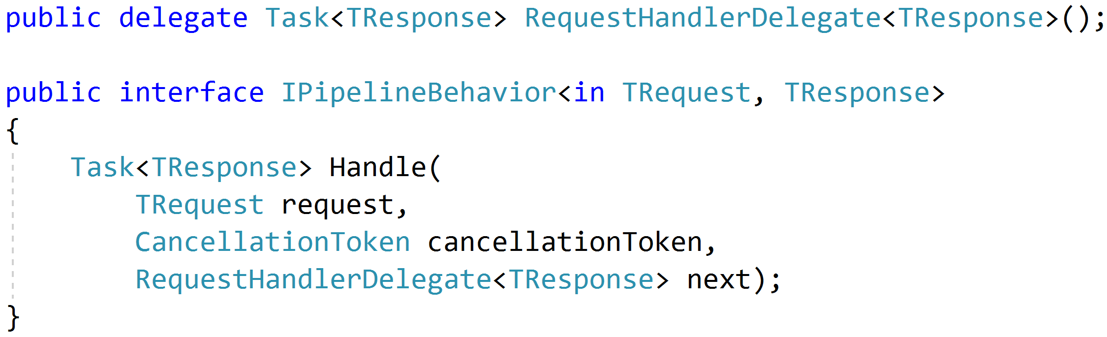
Think: Action Filters

Slide 59
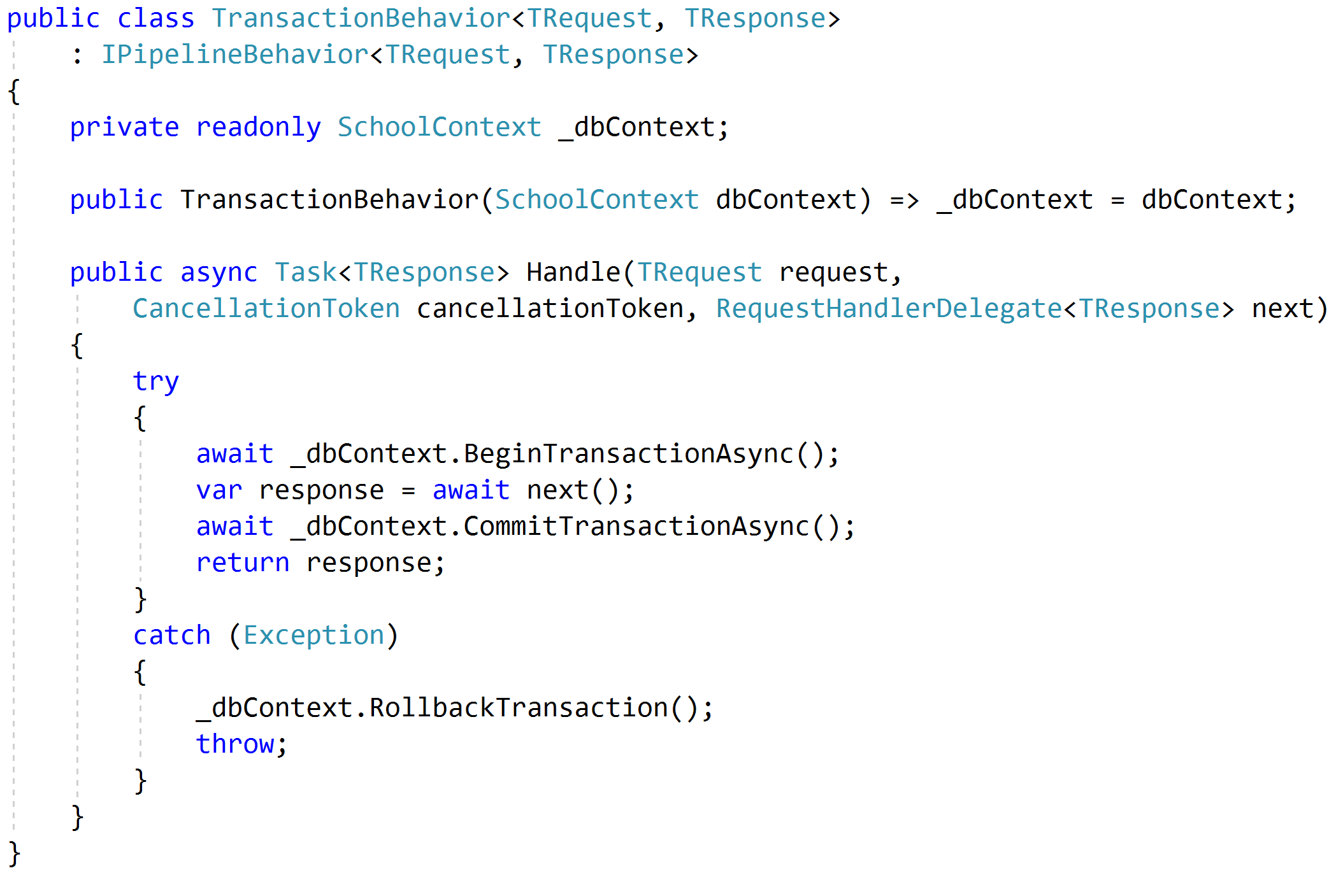
Transactions

Slide 60
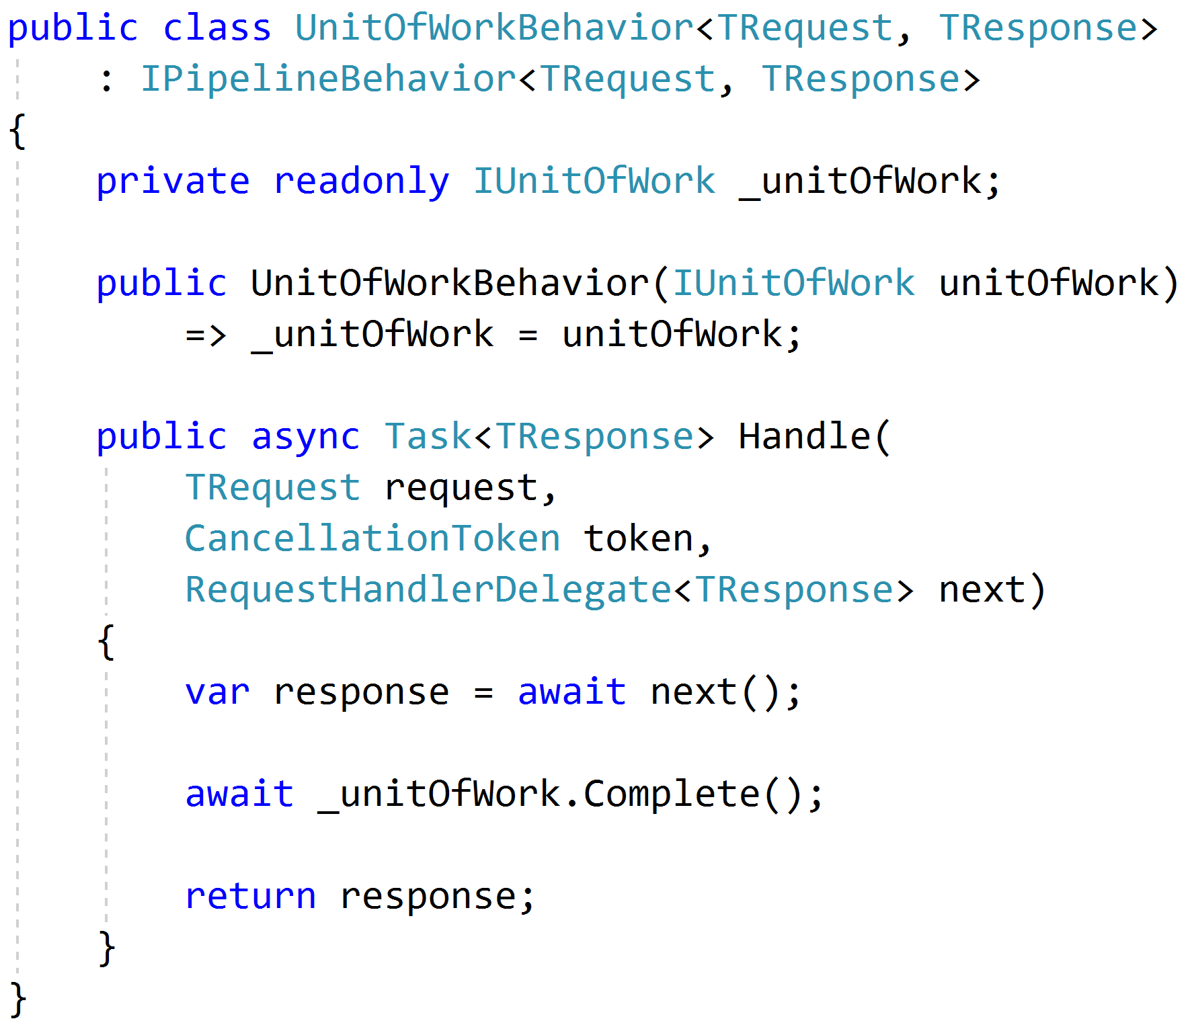
Unit of Work

Slide 61
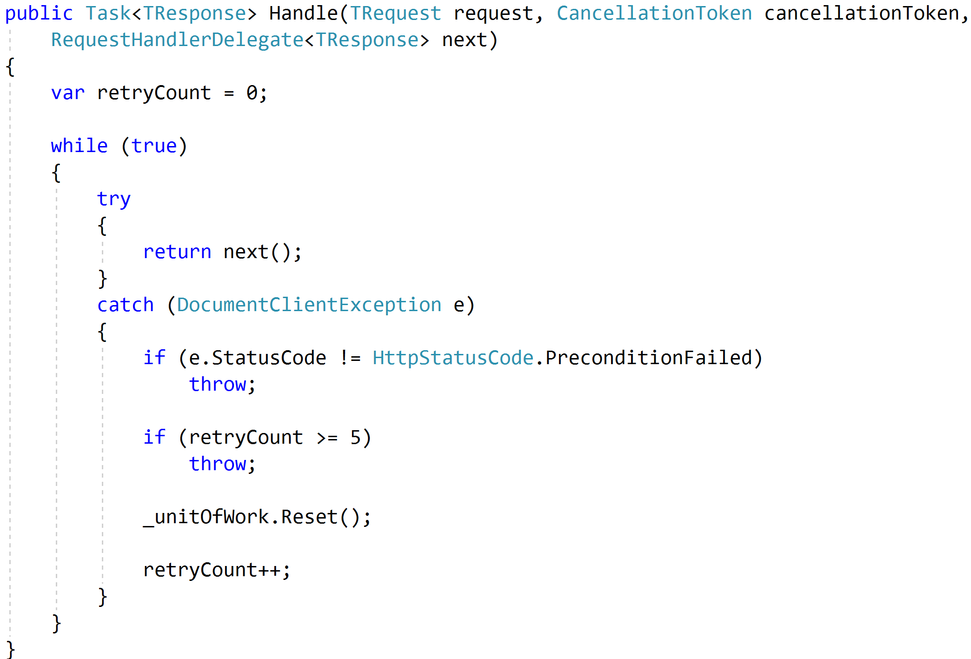
Concurrency and Retries

Slide 62
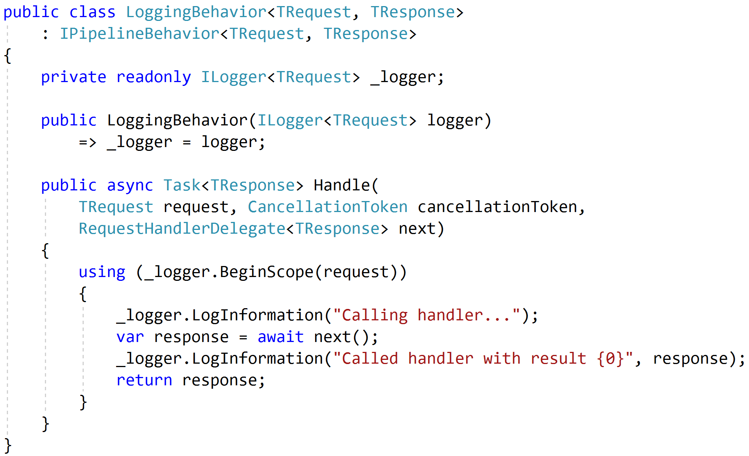
Logging

Slide 63
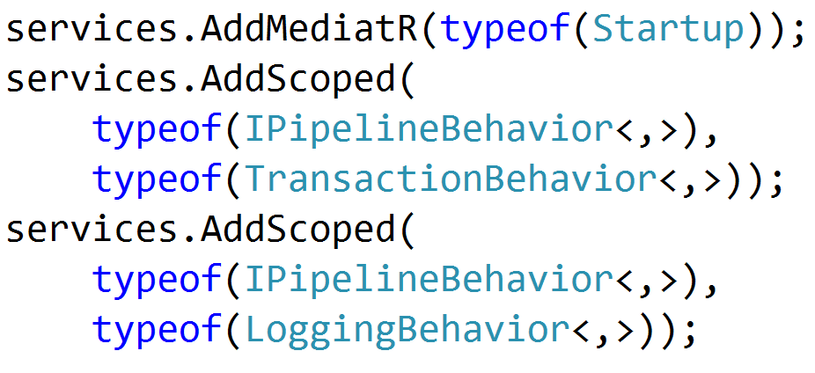

Registration

Slide 64
Testing
Pipeline Behavior
Pipeline Behavior
Pipeline Behavior
Request
Handler
Response
Arrange
Assert
Act

Slide 65
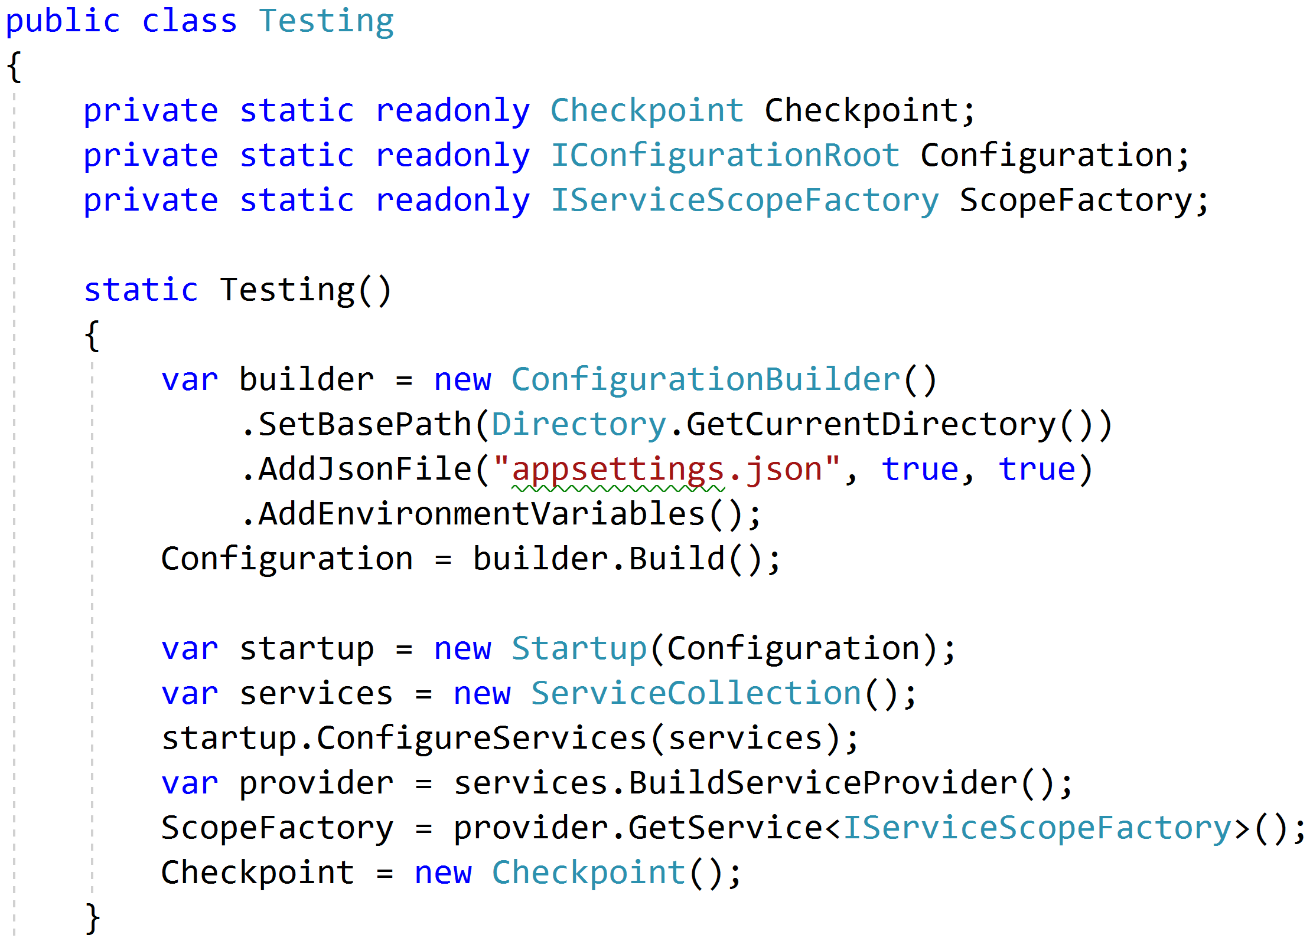
Reproduce Reality

Slide 66
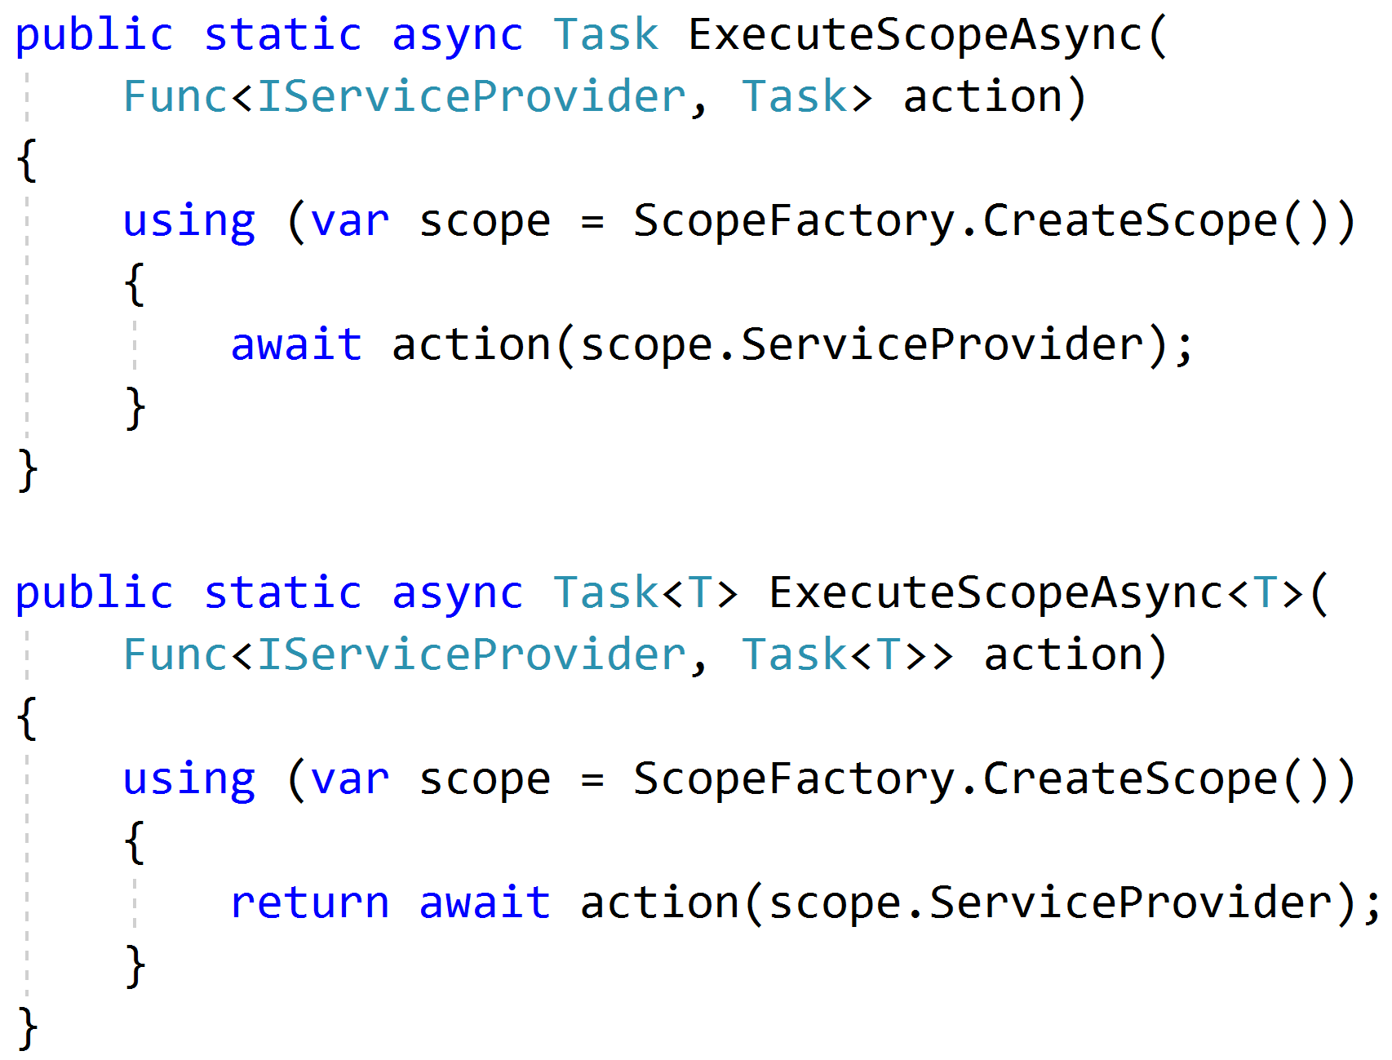
Mimicking Scoped Requests

Slide 67
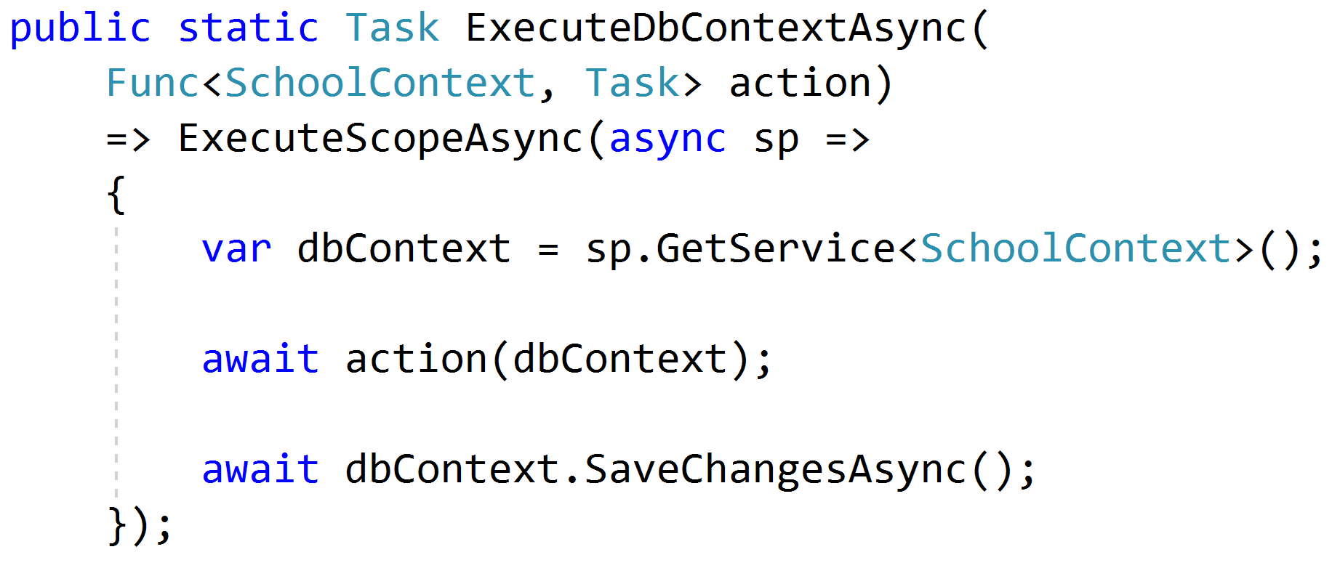
Setting Up Data

Slide 68
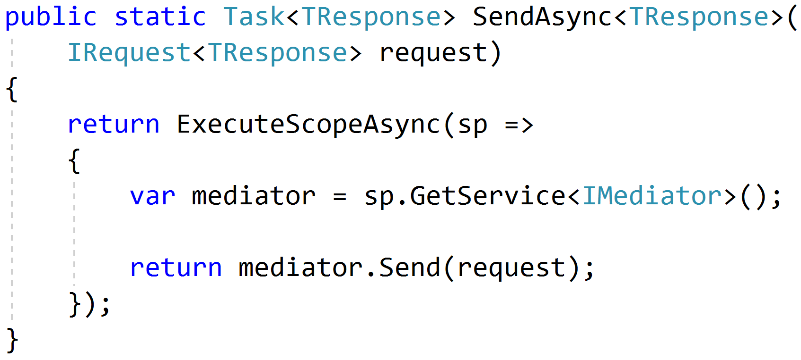
Sending Requests

Slide 69
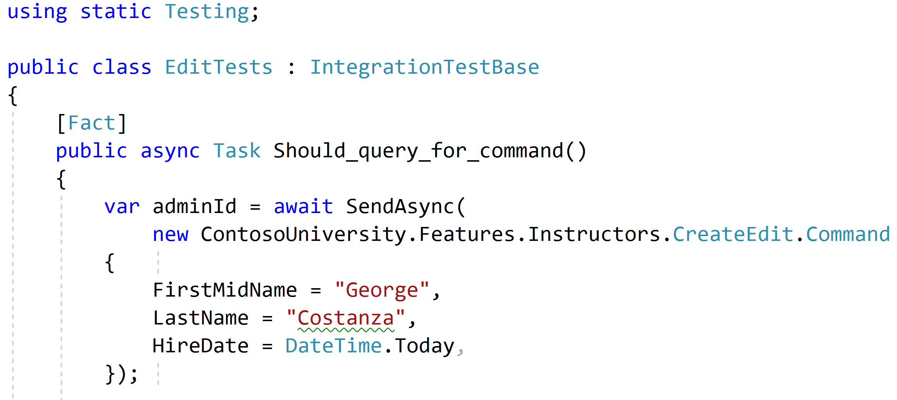
Using static helpers

Slide 70
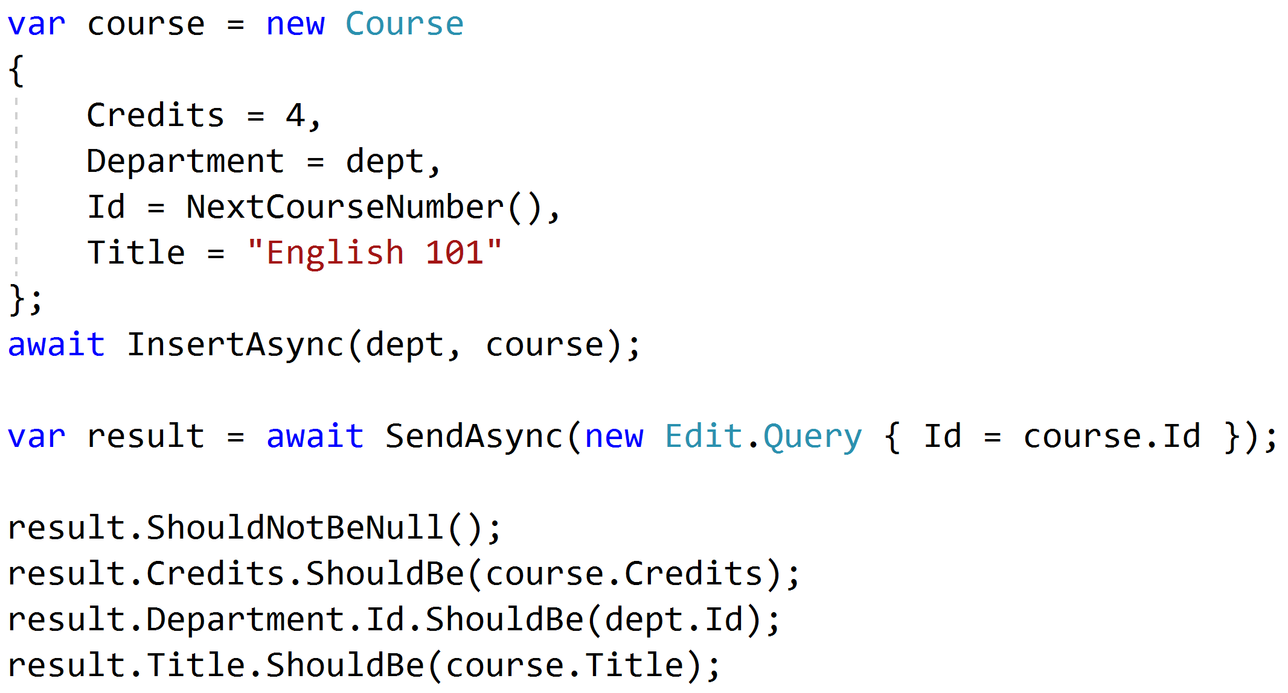
Testing queries through result

Slide 71
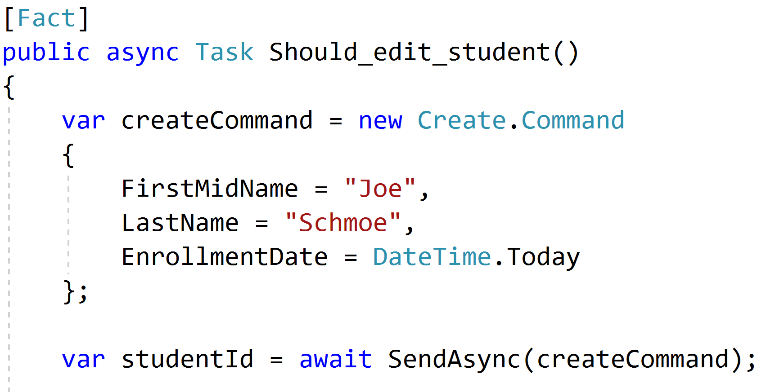
Setup through the front door

Slide 72
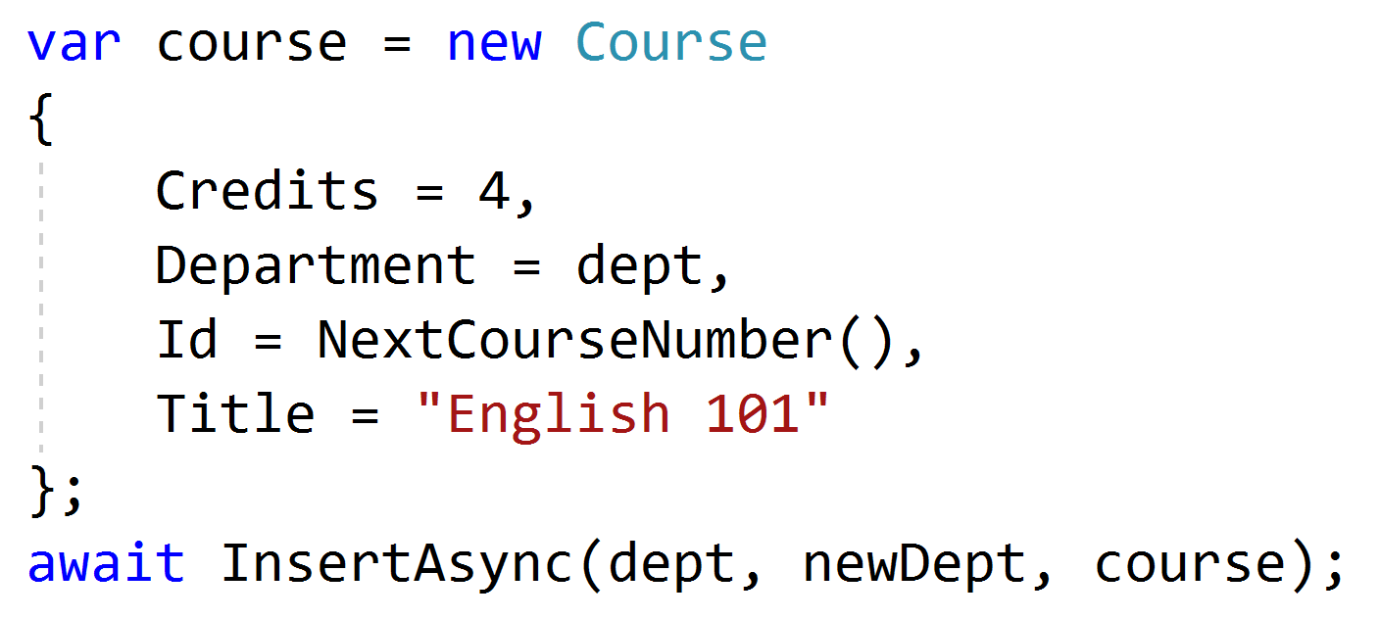
Setup data directly when needed

Slide 73
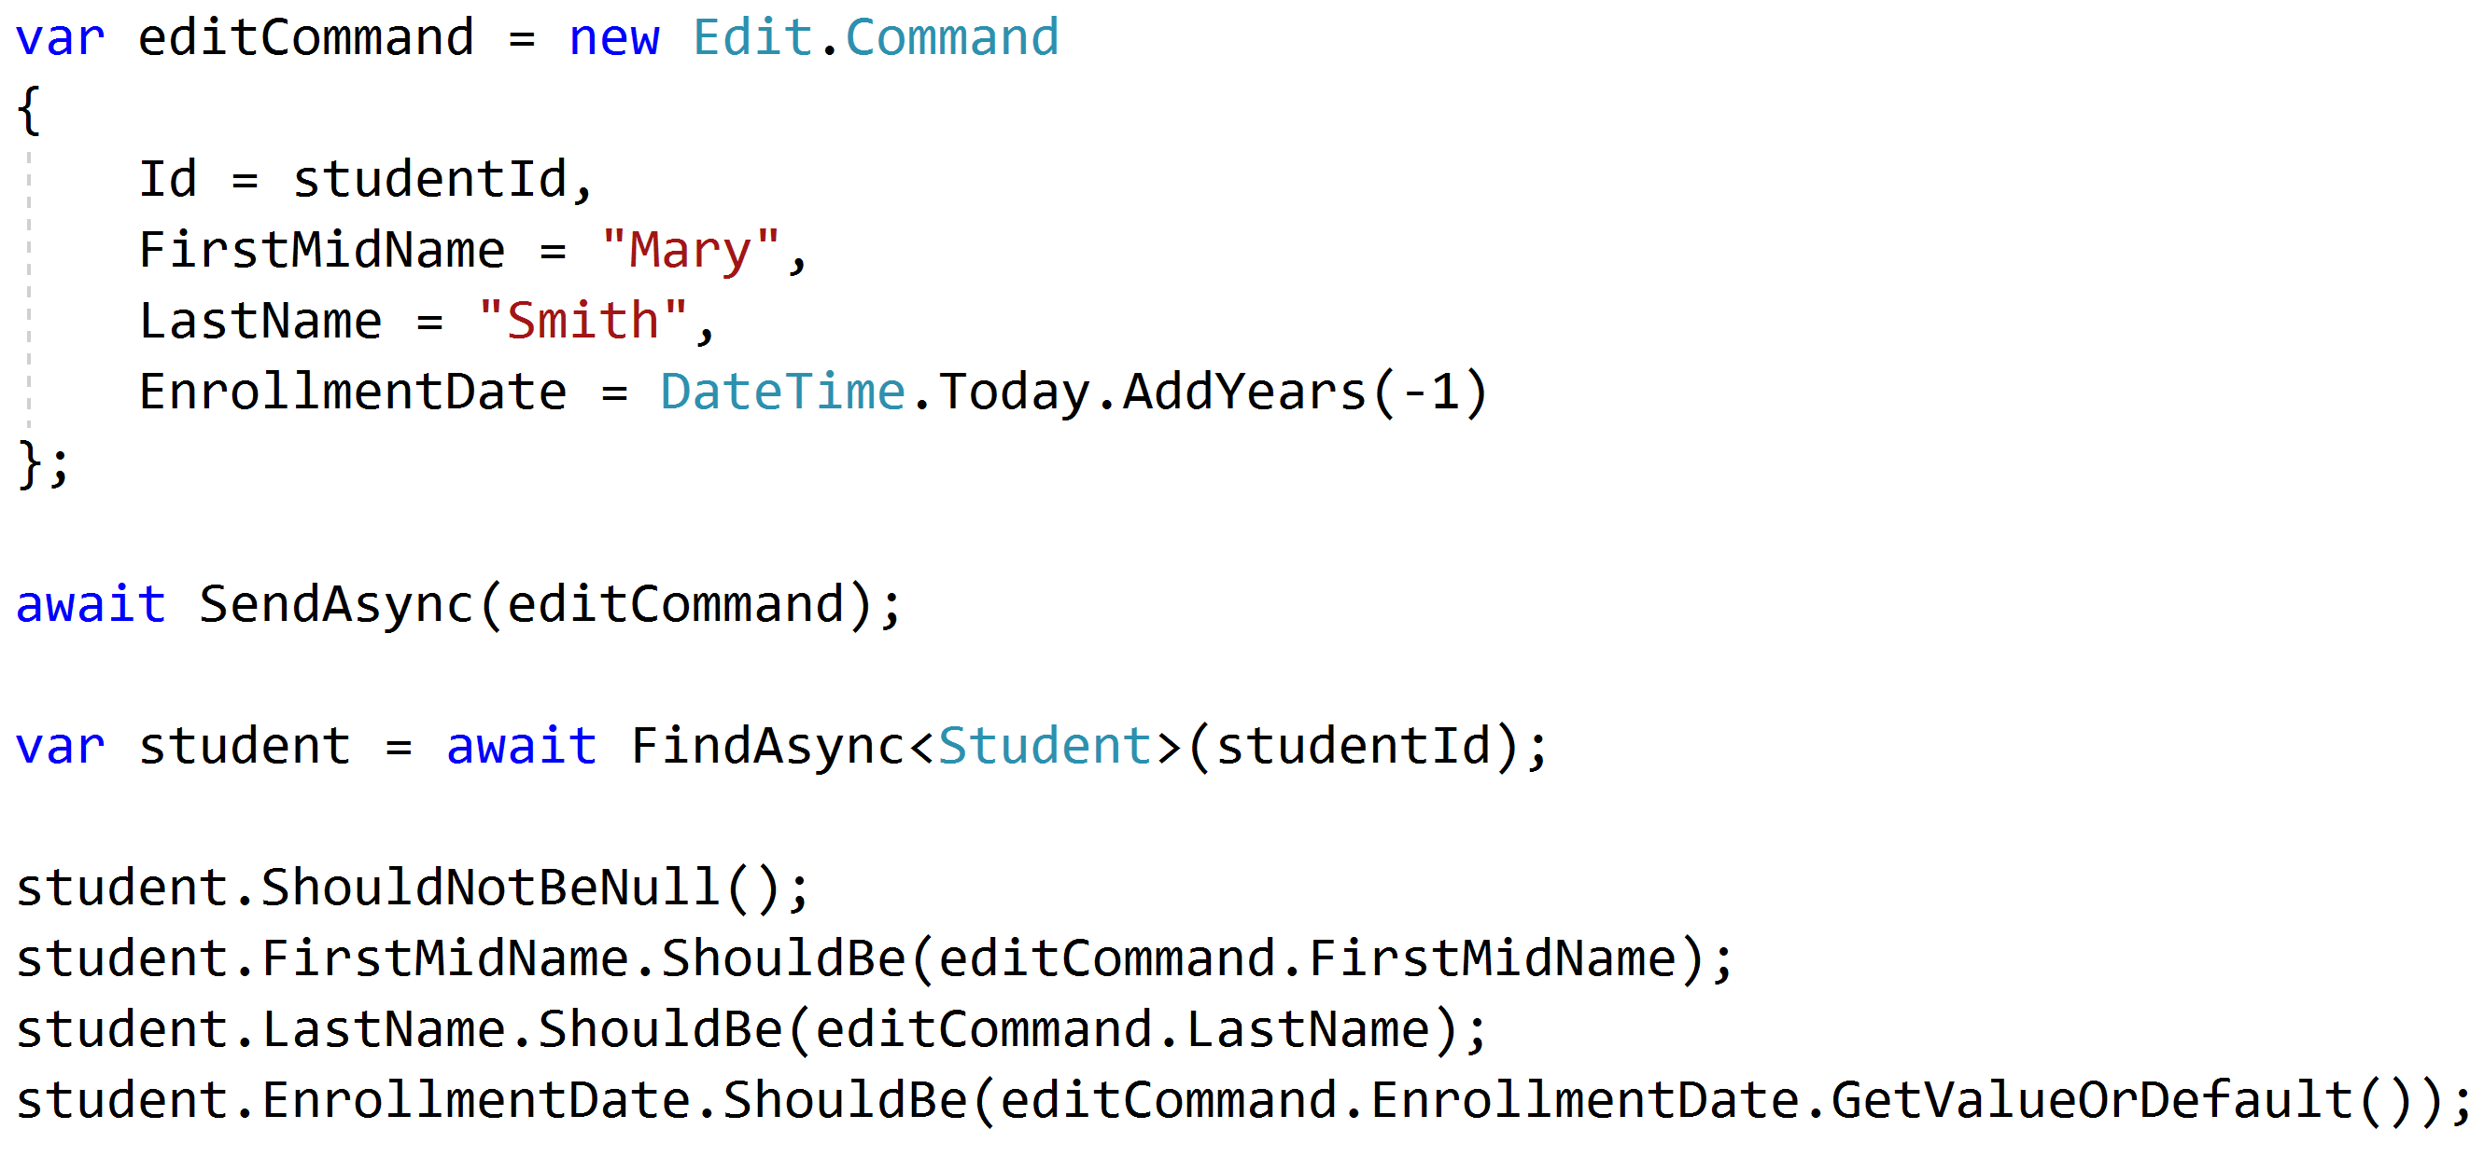
Test commands with roundtrips

Slide 74
Unit and Integration Tests
Pipeline Behavior
Integration Tests
Pipeline Behavior
Pipeline Behavior
Handler
Rich Domain Model
Unit Tests

Slide 75
Key Takeaways
Vertical slices makes code easy to add/change/delete
Do not skip refactor!
Push behavior down
Integration test handlers, unit test domain

Slide 76


Vertical Slice Architecture
Jimmy Bogard
@jbogard
github.com/jbogard/presentations
jimmybogard.com

